Slide 1

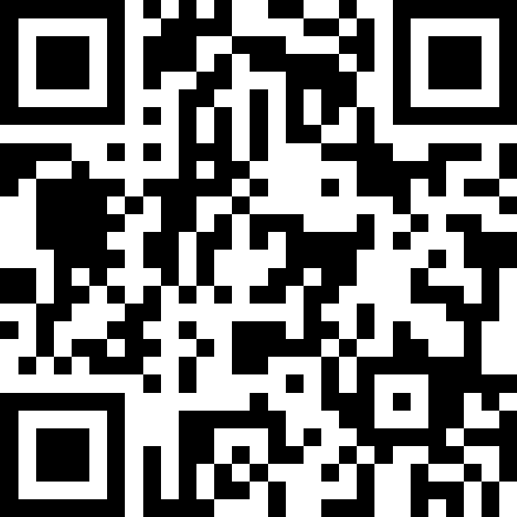
L1
QA ＆Interaction

